Slide 1
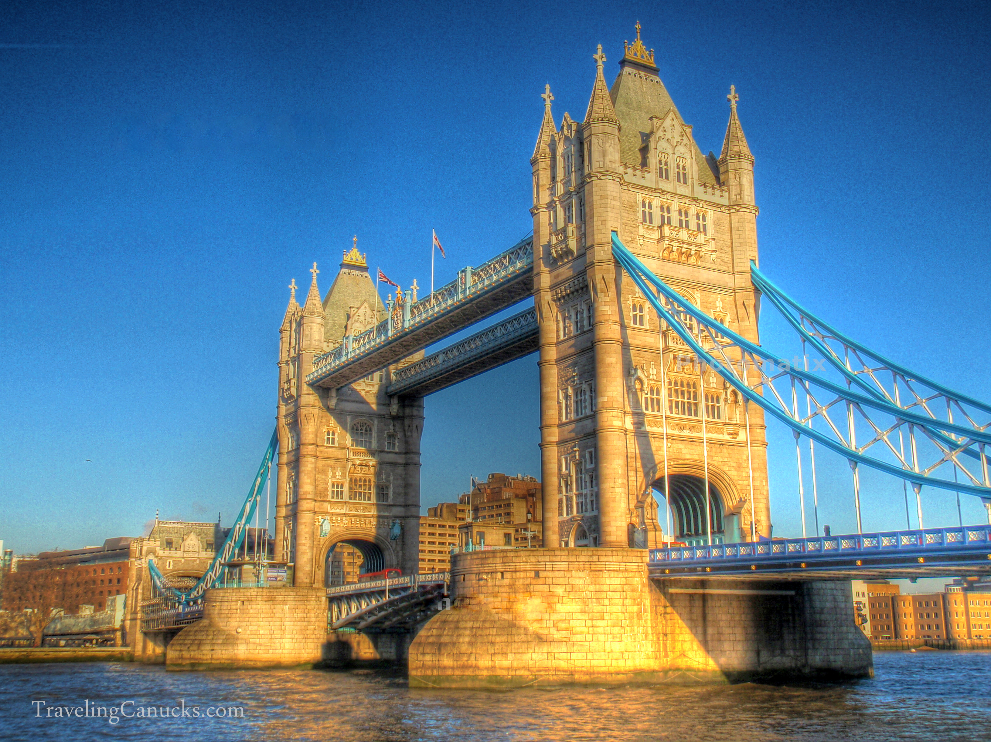
LONDON TOWER BRIDGE
It is a combined bascule and suspension bridgein London built in 1886–1894. The bridge crosses the River Thames.
Some 50 designs were put forward, and in 1884, architect Horace Jones's now iconic design was chosen. Construction cost £1,184,000 and took 432 men eight years to build. Ten men died while working on it. When it was built, Tower Bridge was the largest bascule bridge in the world.
It was originally the only crossing for the Thames but as the population of London grew, new bridges were needed. At this time the east end of London was a thriving, densely populated port being served by hundreds of boats.
Website: http://www.towerbridge.org.uk/
Address: Tower Bridge Rd, London SE1 2UP
Tube Station: Tower Hill / London

Slide 2
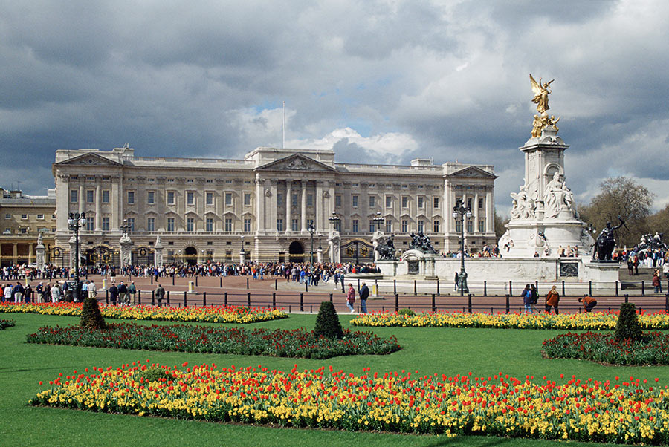
BUCKINGHAM PALACE
It is the London residence and administrative headquarters of the reigning monarch of the United Kingdom.
Located in the City of Westminster, the palace is often at the centre of state occasions and royal hospitality.
It has been a focal point for the British people at times of national rejoicing and mourning.
Every year some 50,000 invited guests are entertained at garden parties, receptions, audiences and banquets. The Garden Parties, usually three, are held in the summer, usually in July.
OPENED: 1703 HEIGHT: 24 m
ARCHITECTURAL STYLE: neoclassical architectural
Website: https://www.royal.uk/search?tags[0]=Buckingham%20Palace
Address: London SW1A 1AA
Tube Station: Victoria, Green Park, St James’s Park or Hyde Park Corner

Slide 3
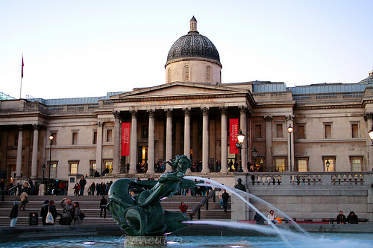
NATIONAL GALLERY
It is an art museum in Trafalgar Square in the City of Westminster, in Central London.
Founded in 1824;
It houses a collection of over 2,300 paintings dating from the mid-13th century to 1900.
It is an exempt charity, and a non-departmental public body of the Department for Culture, Media and Sport.
Its collection belongs to the public of the United Kingdom and entry to the main collection is free of charge. It’s among the most visited art museums in the world, after the Musée du Louvre and the British Museum.
Website: http://www.nationalgallery.org.uk/
Address: Trafalgar Square, London WC2N 5DN
Tube Station: Embankment, Charing Cross and Leicester Square

Slide 4
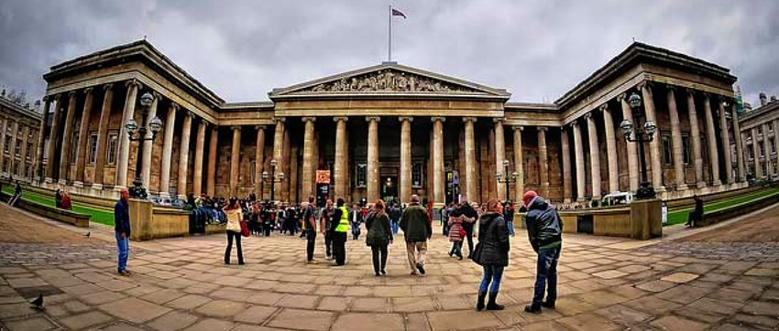
BRITISH MUSEUM
It is dedicated to human history, art and culture, and is located in the Bloomsbury.
Its permanent collection, numbering some 8 million works
It is among the largest and most comprehensive in existence and originates from all continents, illustrating and documenting the story of human culture from its beginnings to the present.
Website: http://www.britishmuseum.org/
Address: Great Russell St, London WC1B 3DG
Tube Station: Tottenham Court Road, Holborn, Russell Square

Slide 5
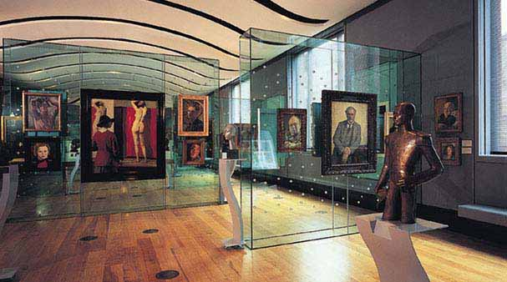
NATIONAL PORTRAIT GALLERY
It is an art gallery in London housing a collection of portraits of historically important and famous British people.
It was the first portrait gallery in the world when it opened in 1856. The gallery moved in 1896 to its current site at St Martin's Place, off Trafalgar Square, and adjoining the National Gallery.
It has been expanded twice since then. The National Portrait Gallery also has three regional outposts at Beningbrough Hall, Bodelwyddan Castle and Montacute House. It is unconnected to the Scottish National Portrait Gallery in Edinburgh, with which its remit overlaps.
The gallery is a non-departmental public body sponsored by the Department for Culture, Media and Sport.
Website: http://www.npg.org.uk/
Address: St. Martin's Place

Slide 6
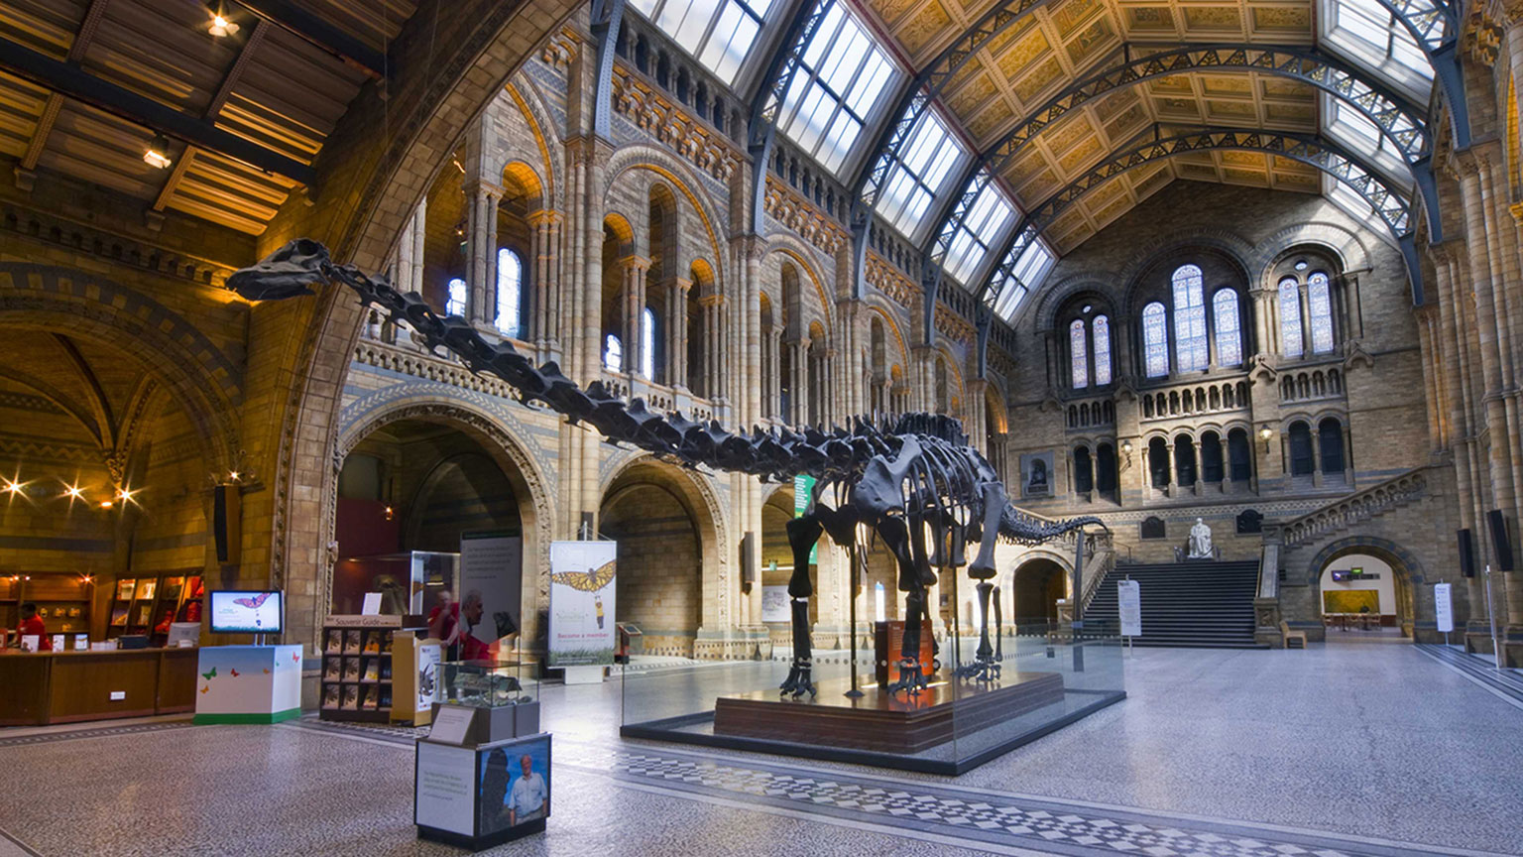
NATURAL HISTORY MUSEUM
It is a museum of natural history that exhibits a vast range of specimens from various segments of natural history.
It is one of three major museums on Exhibition Road in South Kensington, the others being the Science Museum and the Victoria and Albert Museum. The Natural History Museum's main frontage, however, is on Cromwell Road.
The museum is home to life and earth science specimens comprising some 80 million items within five main collections: botany, entomology, mineralogy, paleontology and zoology.
Website: http://www.nhm.ac.uk/
Address: Cromwell Rd, London SW7 5BD
Tube Station: South Kensington

Slide 7
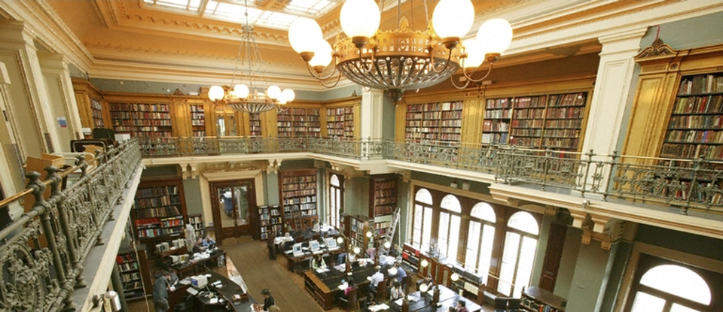
VICTORIA & ALBERT MUSEUM
It is often abbreviated as the V&A
It is the world's largest museum of decorative arts and design, housing a permanent collection of over 4.5 million objects.
It was founded in 1852 and named after Queen Victoria and Prince Albert.
The V&A is located in the Brompton district of the Royal Borough of Kensington and Chelsea, in an area that has become known as "Albertopolis" because of its association with Prince Albert, the Albert Memorial and the major cultural institutions with which he was associated. These include the Natural History Museum, the Science Museum and the Royal Albert Hall.
The museum is a non-departmental public body sponsored by the Department for Culture, Media and Sport. Like other national British museums, entrance to the museum has been free since 2001.
Website: https://www.vam.ac.uk/
Address: Cromwell Road London, SW7
Tube Station: South Kensington, Knightsbridge

Slide 8
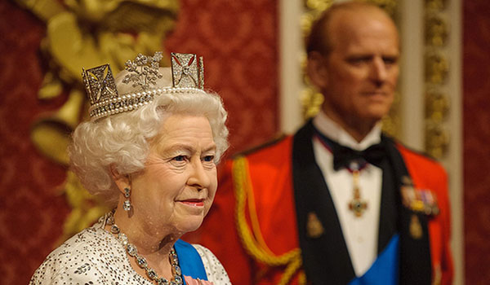
MADAME TUSSAUDS
It is a wax museum in London with branches in a number of major cities. It was founded by wax sculptor Marie Tussaud. It used to be known as "Madame Tussaud's";
Madame Tussauds is a major tourist attraction in London, displaying waxworks of famous people.
It isn’t cheap
Website: https://www.madametussauds.co.uk/london/en/ Address: Marylebone Rd, London NW1 5LR
Tube Station: Baker Street

Slide 9
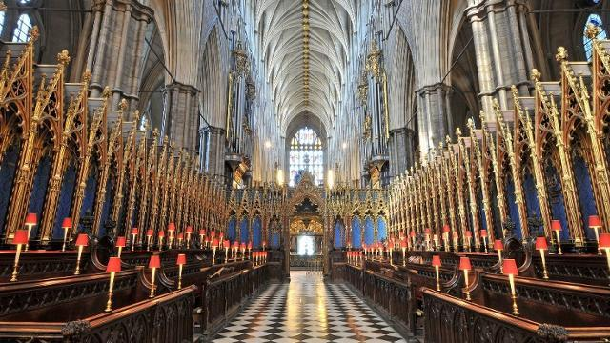
WESTMINSTER ABBEY
Normally titled the Collegiate Church of St Peter at Westminster, is a large, mainly Gothic abbey church in the City of Westminster, London, just to the west of the Palace of Westminster.
It is one of the United Kingdom's most notable religious buildings and the traditional place of coronation and burial site for English and, later, British monarchs. Between 1540 and 1556 the abbey had the status of a cathedral. Since 1560, however, the building is no longer an abbey nor a cathedral, having instead the status of a Church of England "Royal Peculiar"—a church responsible directly to the sovereign. The building itself is the original abbey church
Website: http://www.westminster-abbey.org/
Address: 20 Deans Yd, London SW1P 3PA
Tube Station: Westminster and St James's Park.

Slide 10
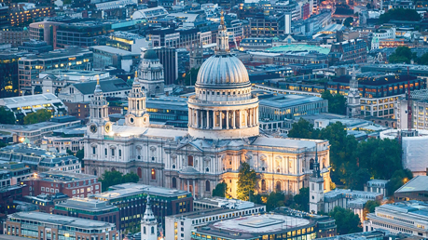
ST PAUL’S CATHEDRAL
It is an Anglican cathedral, the seat of the Bishop of London and the mother church of the Diocese.
It sits on Ludgate Hill at the highest point of the City of London.
Its dedication to Paul the Apostle dates back to the original church on this site, founded in AD 604.
It was designed in the English Baroque style by Sir Christopher Wren.
Its construction, completed in Wren's lifetime, was part of a major rebuilding programme in the City after the Great Fire of London.
It is one of the most famous and most recognisable sights of London.
It was the tallest building in London from 1710 to 1967. The dome is among the highest in the world. St Paul's is the second largest church building in area in the UK.
Website:https://www.stpauls.co.uk/
Address: St. Paul's Churchyard, London EC4M 8AD
Tube Station: St Paul's, Bank, Mansion House.

Slide 11
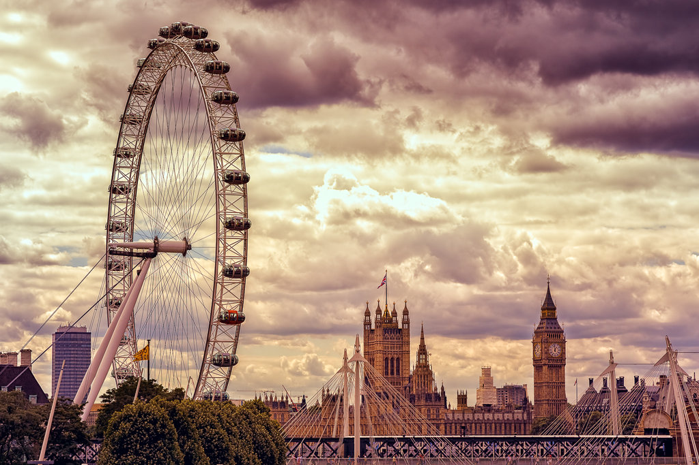
LONDON EYE
It is a giant Ferris wheel on the South Bank of the River Thames in London.
Also known as the Millennium Wheel, it has also been called by its owners the British Airways London Eye, then the Merlin Entertainments London Eye, then the EDF Energy London Eye. Since mid-January 2015, it has been known as the Coca-Cola London Eye, following an agreement signed in September 2014.
The structure is 443 feet (135 m) tall and the wheel has a diameter of 394 feet (120 m).
It is the most popular paid tourist attraction in the United Kingdom with over 3.75 million visitors annually.
Website: https://www.londoneye.com/
Address: London SE1 7PB

Slide 12
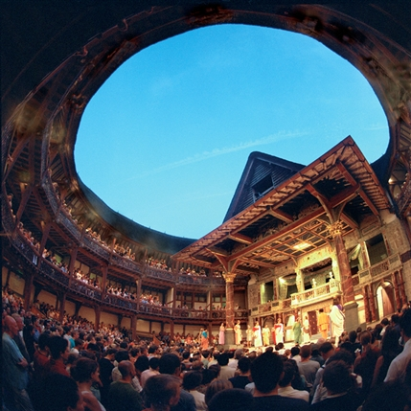
SHAKESPEARE’S GLOBE
It is the complex housing a reconstruction of the Globe Theatre, an Elizabethan playhouse associated with William Shakespeare.
The original theatre was built in 1599, destroyed by fire in 1613, rebuilt in 1614, and then demolished in 1644.
The modern Globe Theatre reconstruction is an academic approximation based on available evidence of the 1599 and 1614 buildings.
It is considered quite realistic, though contemporary safety requirements mean that it accommodates only 1400 spectators compared to the original theatre’s 3000. It was founded by the actor and director Sam Wanamaker, built about 230 metres (750 ft) from the site of the original theatre and opened to the public in 1997, with a production of Henry V.
There is also an exhibition about Shakespeare's life and work, and regular tours of the two theatres.
Website: http://www.shakespearesglobe.com/ Address: New Globe Walk
Tube Station: Mansion House.

Slide 13
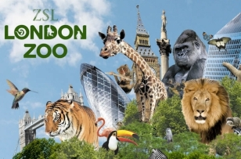
LONDON ZOO
ZSL London Zoo has been educating and inspiring visitors since opening to the public in 1847. With over 750 incredible species, exciting and innovative exhibits it’s a great day out in the capital for all ages. Your ticket helps secure a future for endangered animals by directly contributing to ZSL’s conservation programmes.
Website: https://www.zsl.org/zsl-london-zoo
Address: Outer Circle Regent's Park
Tube Station: Camden Town

Slide 14
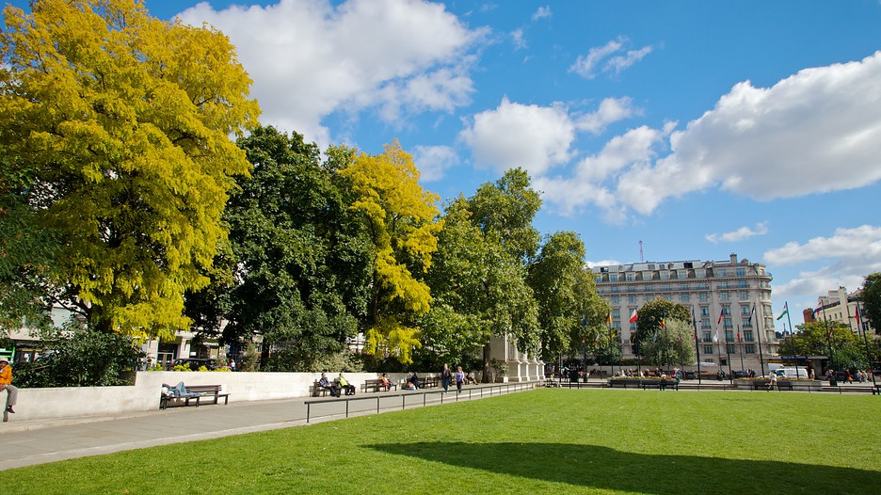
HYDE PARK
Is one of the largest parks in London and one of its Royal Parks.
It was created 1637.
It is the largest of four that form a chain from the entrance of Kensington Palace through Kensington Gardens and Hyde Park, via Hyde Park Corner and Green Park past the main entrance to Buckingham Palace and on through Saint James's Park to Horse Guards Parade in Whitehall.
It divided by the Serpentine and the Long Water.
The area of the park is 625 acres
Website: http://www.royalparks.org.uk/parks/hyde-park
The tube stations that surround Hyde Park are:
Lancaster Gate, Marble Arch, Hyde Park Corner

Slide 15
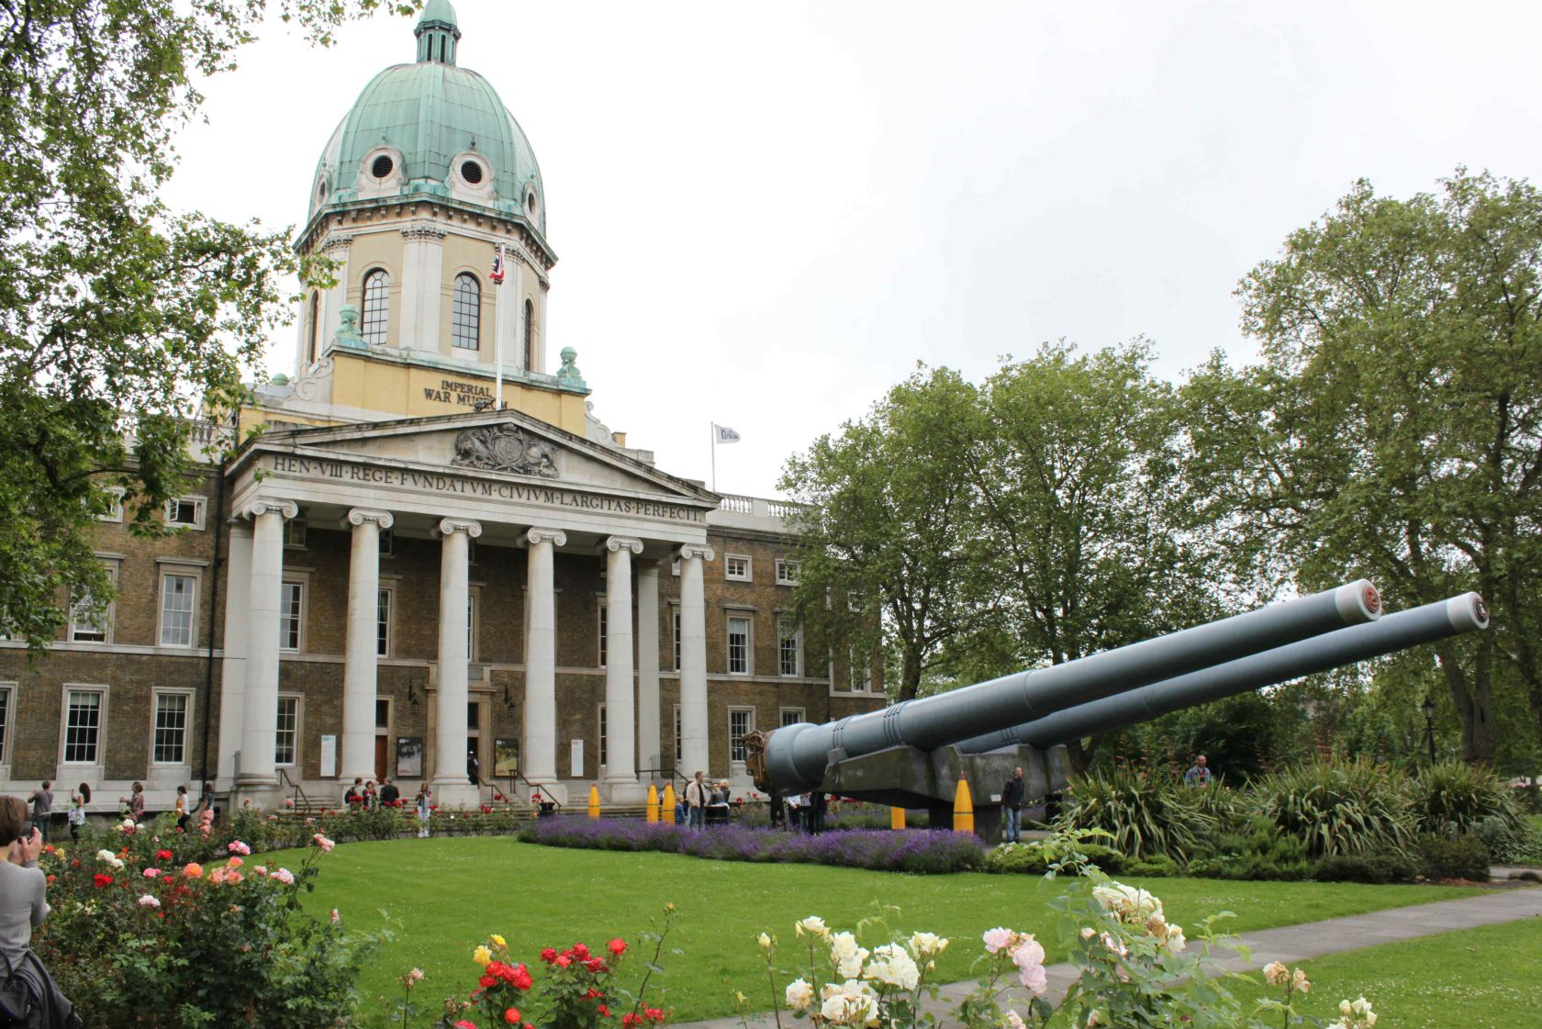
IMPERIAL WAR MUSEUM
is a British national museum organisation with branches at five locations in England, three of which are in London.
Founded as the Imperial War Museum in 1917, the museum was intended to record the civil and military war effort and sacrifice of Britain and its Empire during the First World War.
It is remit has since expanded to include all conflicts in which British or Commonwealth forces have been involved since 1914. As of 2012, the museum aims 'to provide for, and to encourage, the study and understanding of the history of modern war and "wartime experience”.
Website: http://www.iwm.org.uk/
Address: Lambeth Road
Tube Station: Lambeth North, Elephant & . Castle, Waterloo

Slide 16
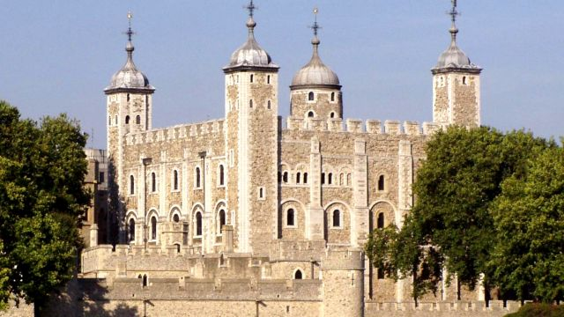
TOWER OF LONDON
Is a historic castle located on the north bank of the River Thames in central London.
It was founded towards the end of 1066 as part of the Norman Conquest of England. The White Tower, which gives the entire castle its name, was built by William the Conqueror in 1078.
The castle was used as a prison from 1100 until 1952.
It served as a royal residence. As a whole, the Tower is a complex of several buildings set within two concentric rings of defensive walls and a moat.
Website: http://www.hrp.org.uk/tower-of-london/
Address: London EC3N 4AB, UK
Tube Station: Tower Hill

