Slide 1
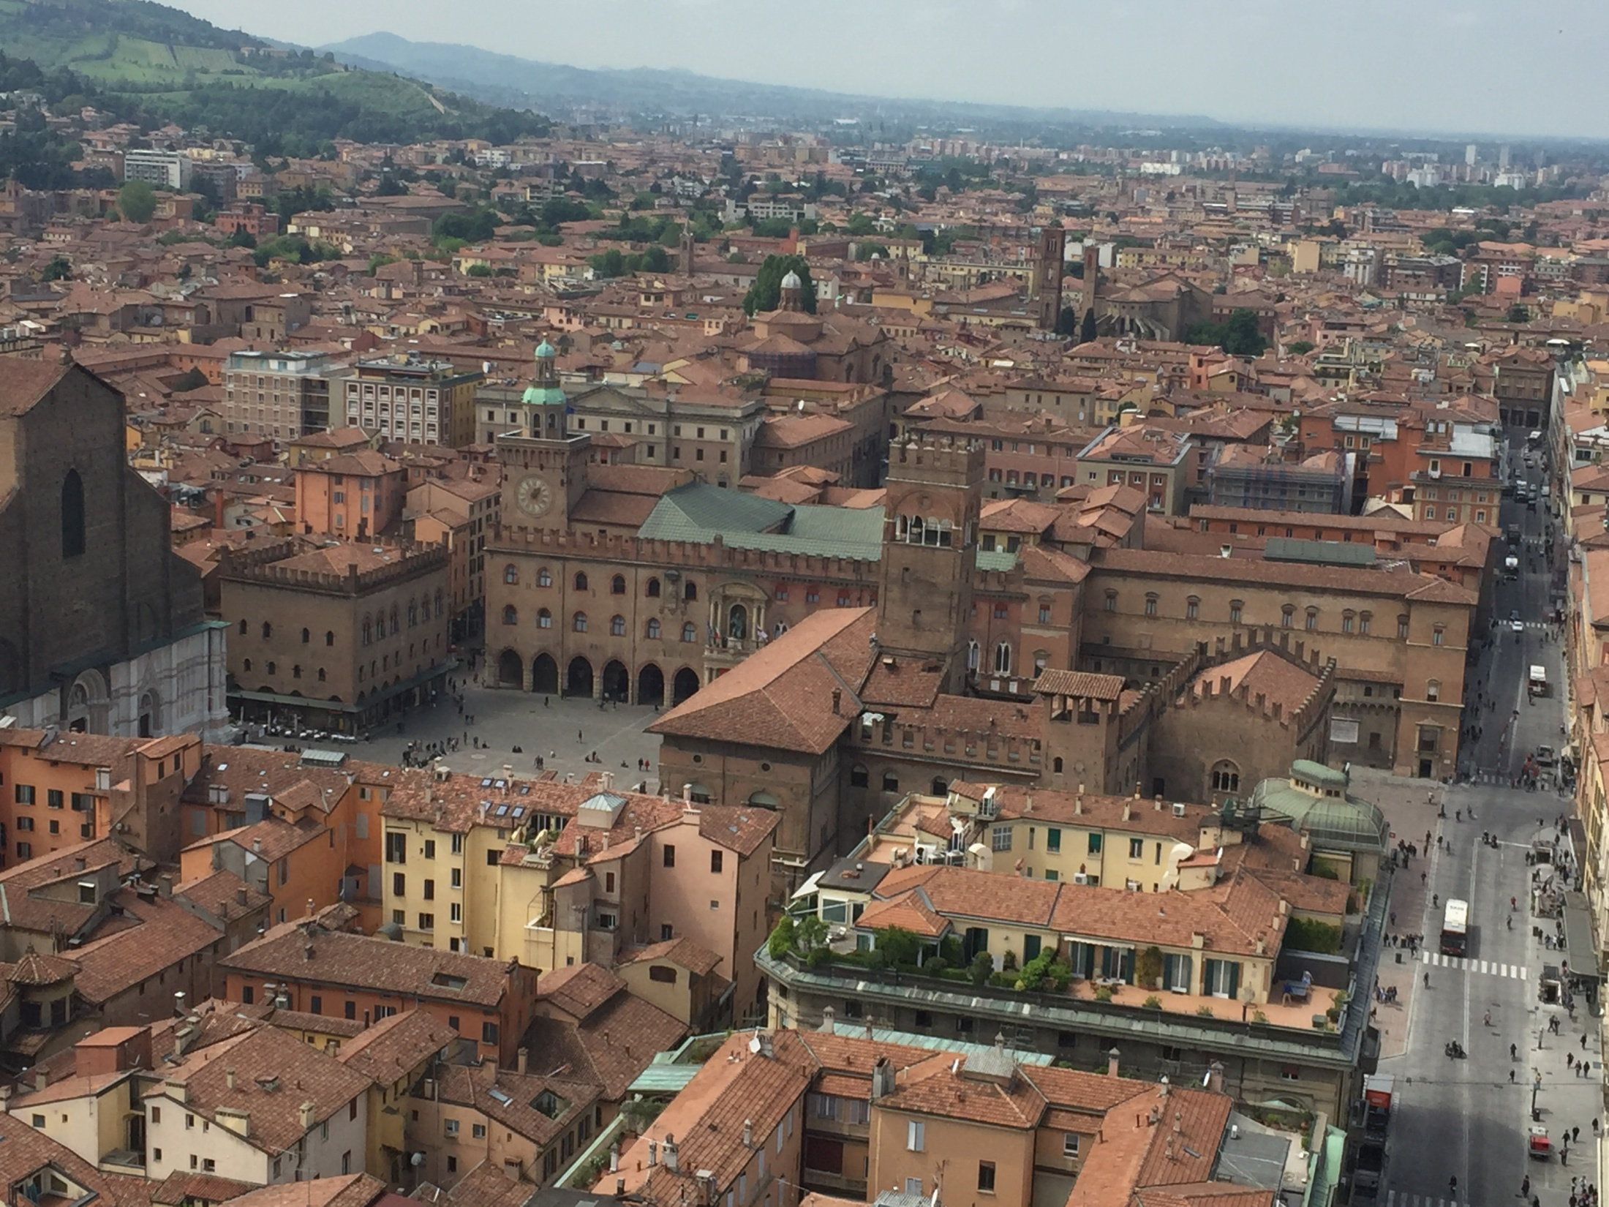
Day trip in Bologna
Bologna is the largest city of the Emilia-Romagna. It is located in the heart of a metropolitan area of about one million. An important cultural and artistic centre, its importance in terms of landmarks can be attributed to a varied mixture of monuments and architectural examples as well as works of art which are the result of a first class architectural and artistic history.
ITALY TOUR
1 day
at
€ 30,00
PRICE INCLUDES
English speaking guide
Transport by air-conditioned
Lunch at “Cocoà” in the heart of the city
PRICE DOES NOT INCLUDE
Gratuities (optional)
Highlights:
11:30 arrival in Bologna
11:50 visit to the Piccola Venezia
12:00 visit to the Voltone del Podestà
12:10 visit to the Neptune’s Fountain
12:20 visit to the Basilica of San Petronio
12:50 visit to the Asinelli Tower
13:30 lunch at “Cocoà” and free time
15:00 visit to the Basilica of Santo Stefano
16:00 visit to the Lucio Dalla’s Home
16:30 departure to return to Novara
20:00 arrival in Novara
AGENZIA FUFFAH s.r.l - Sito internet: www.advfuffah.com – e-mail: advfuffah@info.com
Via Mario Rossi, 30 – 28019 SUNO – Tel. 0322/85319 – Fax. 0322/85109

